Slide 1
Dr. JITHESH KRISHNAN R.
Asst. Professor,
Dept. of Botany
NSS College, Pandalam

Slide 2
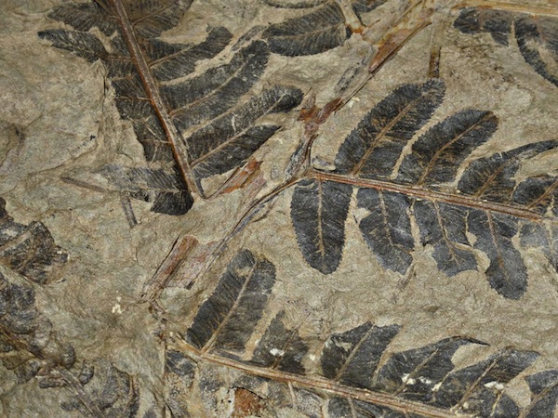
FOSSIL PtERIDOPHYTE- SPHENOPHYLLUM & ZYGOPTERIS

Slide 3
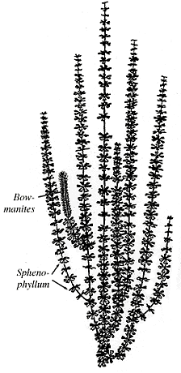
SPHENOPHYLLUM

Slide 4
SPHENOPHYLLUM
This fossil genus appeared in Upper Devonian period & become extinct in the Triassic period
The central axis of the aerial shoot was slender irregularly branched .
The stem is delicate & divided into nodes & internodes.
On the nodes leaves are formed leaves are in whorled arrangement.
Usually 6-8 leaves were present on the each nodes.
The internodes of the stem is longitudinally ribbed .This character is similar to Sphenophylls.

Slide 5
ANATOMY OF STEM
Resemble with root.
At the centre a triangular mass of primary xylem present .
Actinostelic stele
Cortex consist of peripheral region of thick walled cells & inner region of thin walled cells.
Stem shows secondary growth. Out side the primary xylem a ring of cambium is formed.
In the secondary wood ,a pitted tracheids and xylem parenchyma is present .
After the starting of cambial activity, the periderm is developed on the inner portion of the cortex.

Slide 6
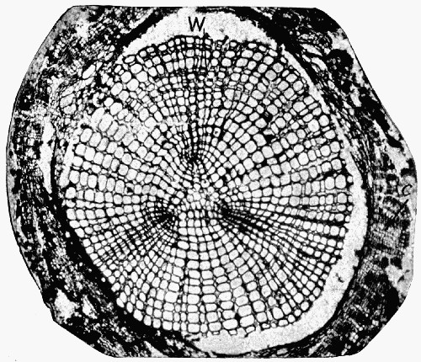
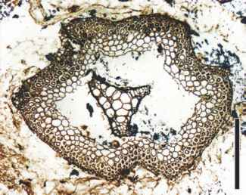
The periderm consist of radially arranged cells.
Root is diarch & rarely triarch
SPHENOPHYLLUM SECONDARY WOOD
STEM ANATOMY

Slide 7
ZYGOPTERIS
It has several species but extensively studied species is Z.primeria.
Plant body is tree like and having a trunk which is 20 cm in diameter.
The main stem bears elaborately branched stem & leaf having a no. of leaf stalks. These are usually cylindrical, leaf stalk has no pinnai . Leaf stalk is called etapteris.

Slide 8
Various names have been given to the fruit formation of zygopteris eg:Corynopteris.
The sporangia are large and ovulate, they are sessile and are grouped into spherical structure.
The wall of the sporangium has a broad band like annulus. The sporangial cavity is filled with homosporous spores.

Slide 9
ANATOMY
Stem
The primary xylem is surrounded by a secondary wood.
It has a xylem cylinder consist of scalariform trachieds.
Etapteris
It internally shows a vascular strand ,which is ‘H’ shaped with a straight median band. Two small protoxylem points at the end of the median band.

Slide 10
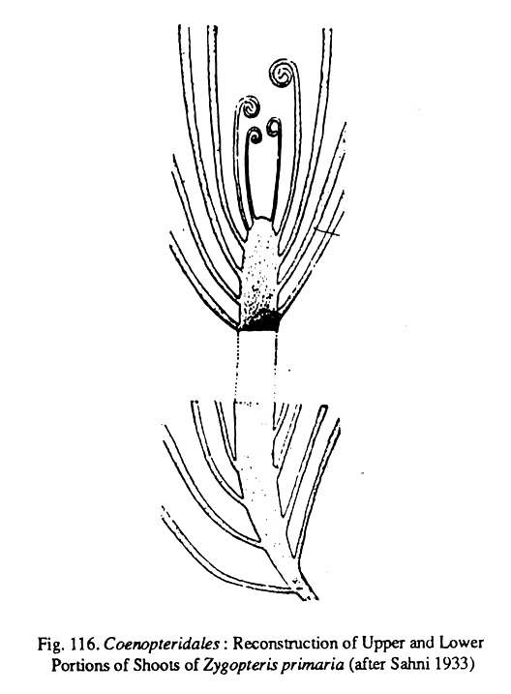

Slide 11
THANK YOU

